Slide 1
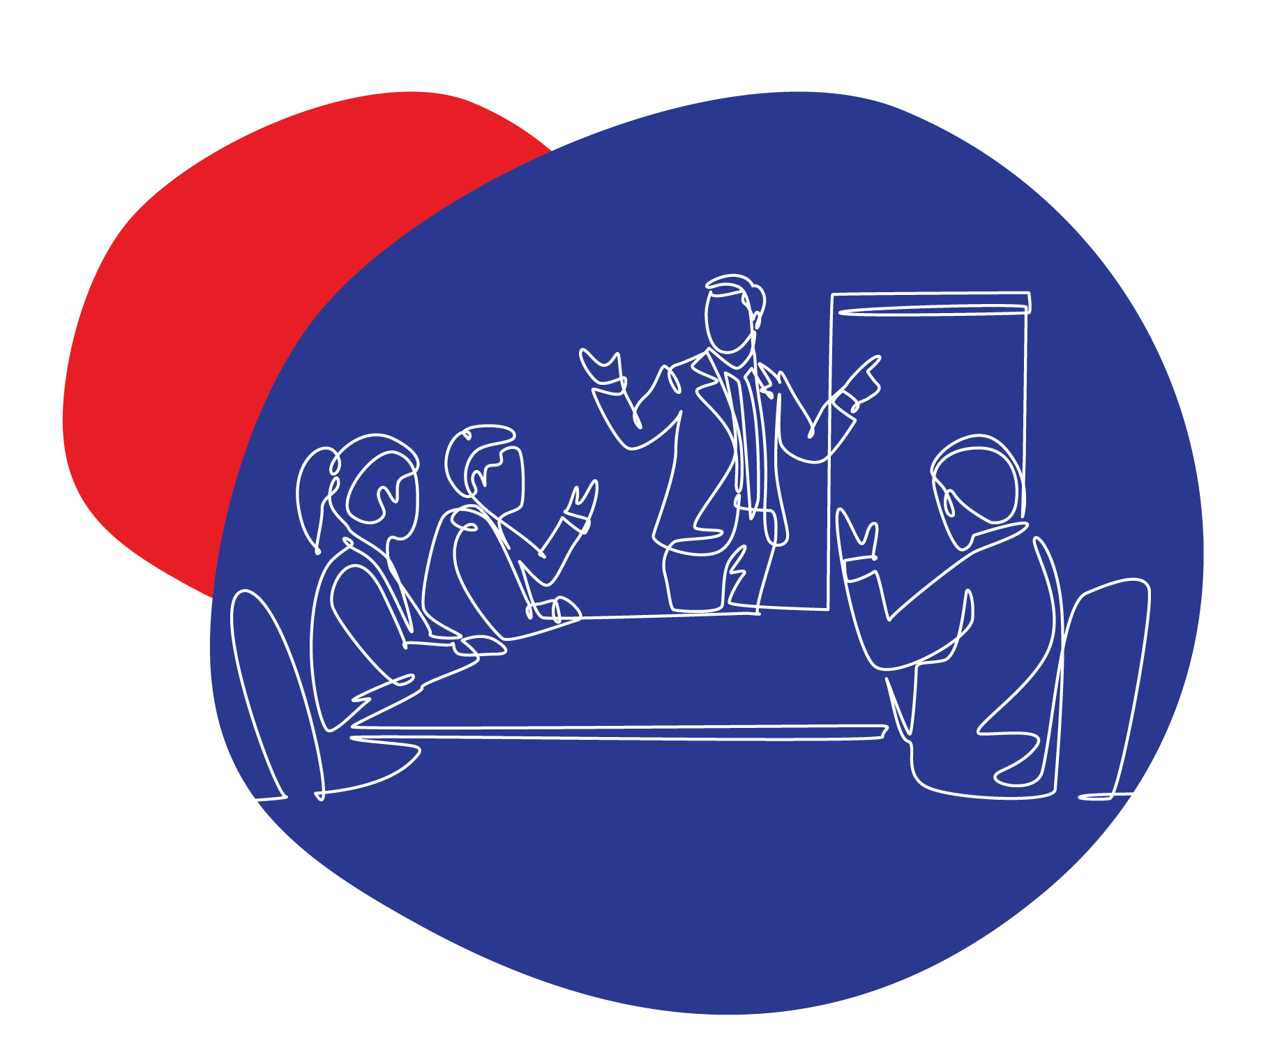




FORGET MARKETING
Let’s talk communications
Brad ChicagoFire Watridge
📊Strategist I 🔮Mentor I Speaker I Ex⭯plorer l Dad

Slide 2



Adam’s Apple
What is the core of business ownership. The single point of departure, the one thing we do hourly, daily, weekly and annually. What is our poison?

Slide 3
Sell to Survive?
Selling is defined as giving or handing over (something) in exchange for money.

Slide 4
Connect to Collect
Communication is defined as the imparting or exchanging of information by speaking, writing, or using some other medium.

Slide 5
The Eye of The Storm
Communication is your core, the place of truth, passion, pleasure and profit.
Bullseye and be intentional
Consistently brand your senses
Play on your customer's senses, yes all of them!
Engage and interact
Tell your success story
Focus on content

Slide 6
The Power Within
Set Daily Communication Goals:
Establish specific communication goals for the day, such as initiating a
certain number of conversations or making follow-up calls.
Practice Active Listening:
Actively listen when others are speaking, ask questions to understand
their points better, and show you value their input.
Embrace Self-Reflection:
Take a few minutes each day to reflect on your communication experiences, noting areas of improvement and what you did well.
Engage in Small Talk:
Initiate conversations with colleagues, clients, or contacts using light and friendly topics to build rapport and ease into more substantial discussions.
Join Communication Workshops or Courses:
Enroll in workshops or courses that focus on communication skills, providing structured learning and opportunities for practice.

Slide 7
The Power Within
Set Clear Communication Goals:
Define specific communication objectives for your business interactions
Reflect and Adapt Daily:
Encourage a culture of self-reflection within your business. Encourage
team members to reflect on their daily communication interactions,
identifying areas for improvement and celebrating successes.
Promote Engaging Small Talk:
Encourage your team to initiate friendly small talk as a way to connect with clients, colleagues, and stakeholders on a personal level. This can lead to stronger relationships and more productive conversations.
Invest in Communication Training:
Recognise the importance of ongoing communication skills development. Invest in workshops, courses, or training programs for your team to improve their communication abilities, whether it's in sales, negotiations, or team collaboration.

Slide 8
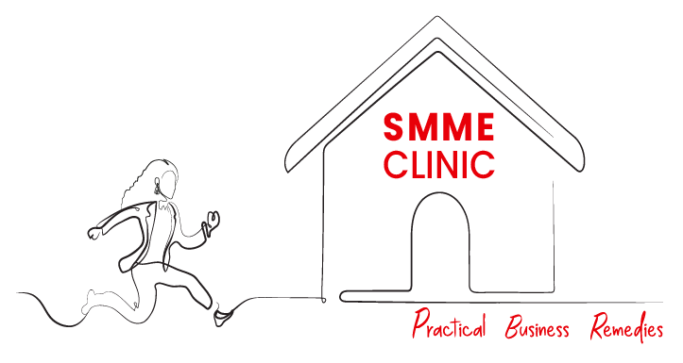
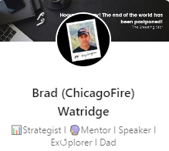

Thank You
Brought to you by

