Slide 1





Managing your online reputation
Vanessa Goosen
Lemoen Marketing

Slide 2
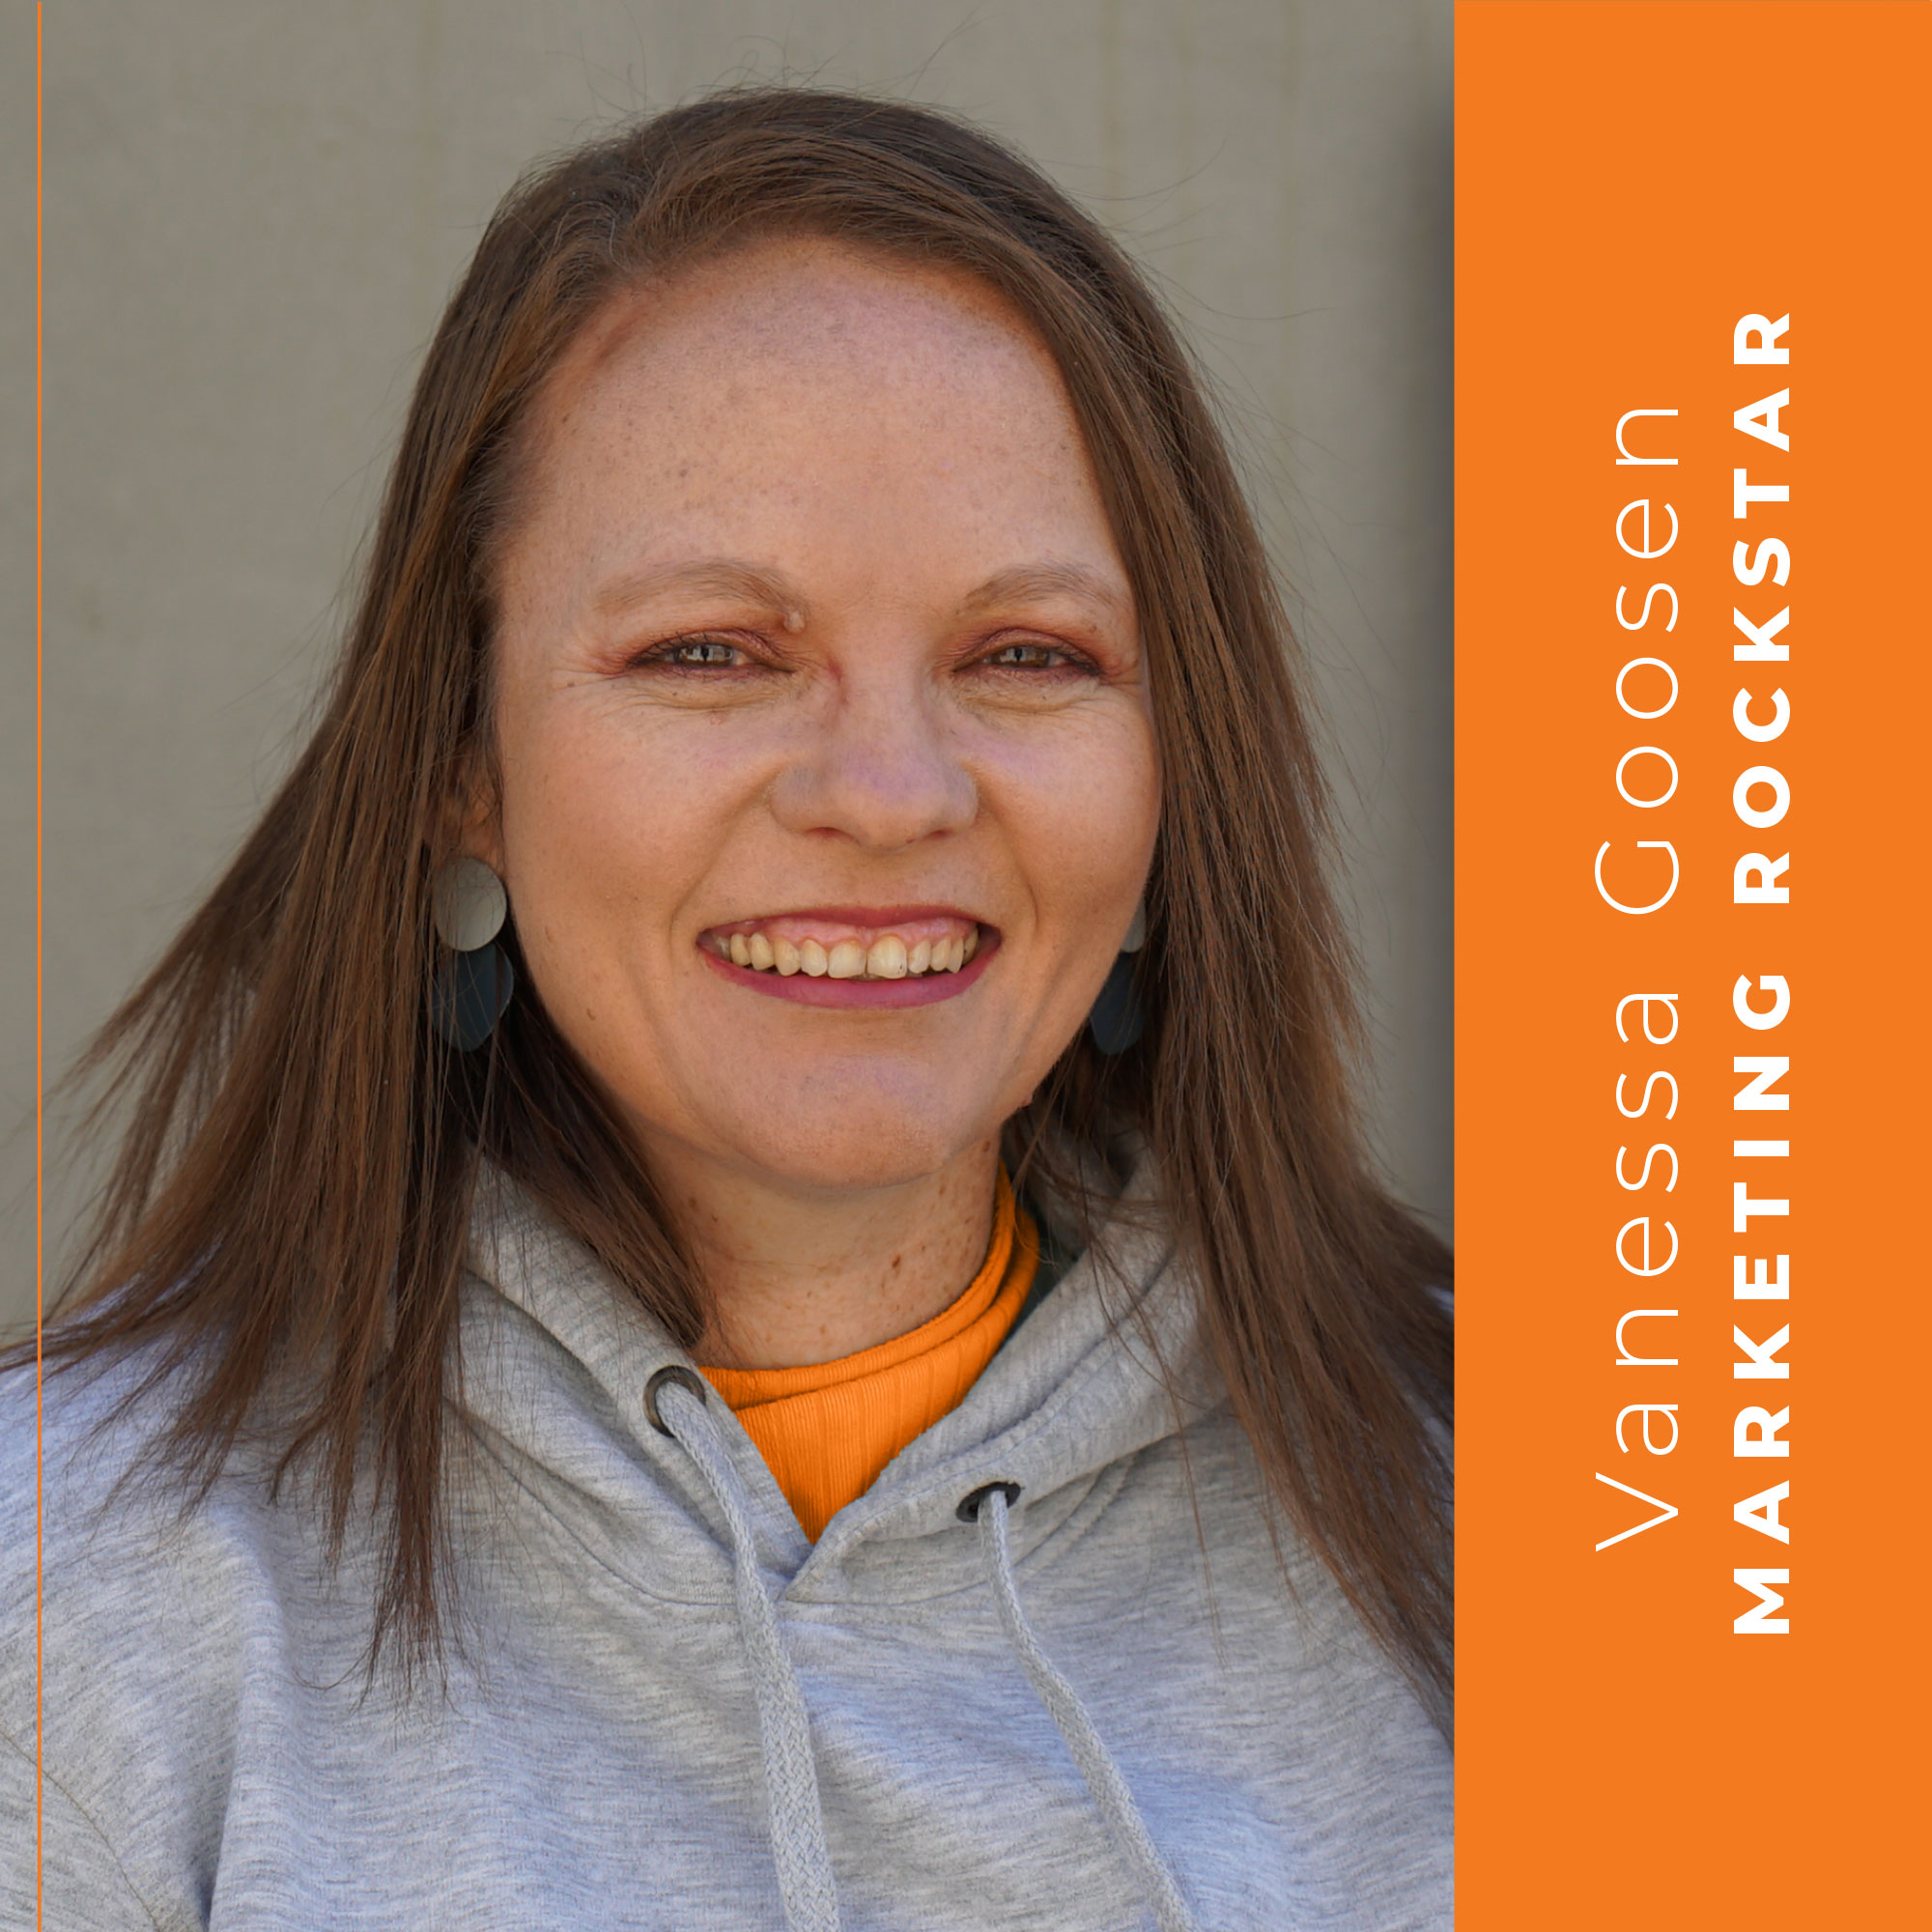

A bit about me…
Experience within advertising agency environments & corporates
Passionate about understanding the changes in consumer behaviour and the latest marketing trends.
Co-owner of Lemoen Marketing, a digital marketing agency
Three dogs, two cats, two teenagers and one husband

Slide 3
How do you define reputation
and why should you care?

Slide 4
How can we build on that echo – what specific things can we do?

Slide 5
Trust radar
Expertise | Empathy | Commitment | Transparency

Slide 6
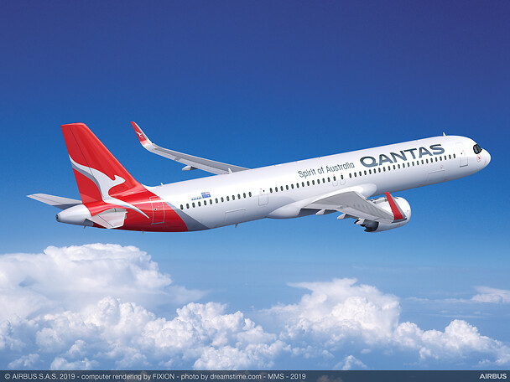
The good, the bad & the horrible comments
#QantasLuxury

Slide 7
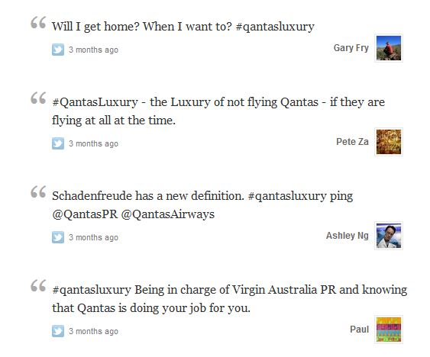
The good, the bad & the horrible comments
#QantasLuxury

Slide 8
It’s not what happens,
it’s how you choose to deal with it

Slide 9

What ingredients makes a successful communication recipe?
Audience
Intent
Message

Slide 10
Google My Business
https://business.google.com
Google my business is a free tool that assists businesses to be accessible on Google maps & Google search.
49% of businesses listed on Google My Business receive
1000+ views & 59 actions monthly.
Complete & accurate Google My Business listings get
7x more clicks & 70% more likely to attract visitors
The ”how to” guide is here: https://statusbrew.com/insights/google-my-business-analytics/

Slide 11
Content pillars - use this to prompt ChatGPT
 | Content Pillar | Type of content | Key Performance Indicator | Call-to-action | Notes
Pillar 1 | Generate demand (this is to build awareness and evoke emotion) | Aspirational (what is your vision) Shareable | Shares Follows Reach | Share this with a friend | Save this post | For example: Show the lifestyle that your brand supports | What value do your brand offer | What feeling will your customers get when they buy your product
Pillar 2 | Convert demand (this is more analytical) | Features and benefits of your product or service Clickable | Sales Clicks/Traffic Leads | Click the link in bio | Learn more | Shop Now | Visit our website | Give information that a customer needs to decide if the product/service is right for them
Pillar 3 | Loyalty/Advocacy (this is your brand persona/enhanced value) | Behind the scenes Memes Meet the Team Advice/Reminders | Comments Order Value | Leave a comment below | Tag someone in the comments | How many years have you been servicing clients | Showcase your brand persona | Public Holidays

Slide 12

Final thoughts

Slide 13

Questions or comments?

Slide 14
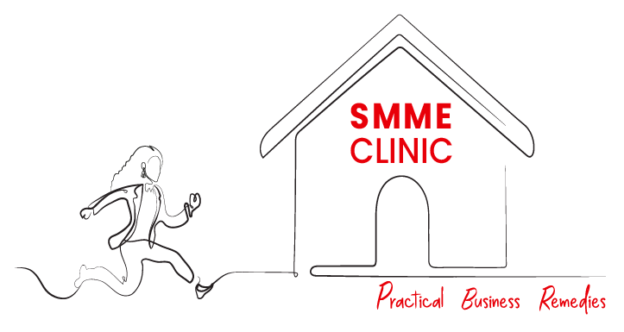

Thank You
Brought to you by

