Slide 1







SMME Clinic Community Building
Paul Hartnady
HOW TO BUILD A FINANCIAL BUSINESS MODEL
– AN ESSENTIAL FOR ANY SME
Brought to you by
In Partnership with

Slide 2


Brought to you by
In Partnership with

Slide 3
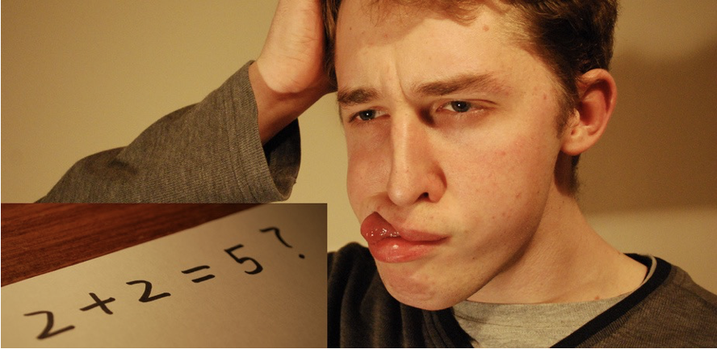
CAN YOU ACCURATELY ANSWER THE FOLLOWING QUESTIONS?
1. WHAT ARE THE SPECIFIC & QUANTIFIABLE FINANCIAL RISKS IN YOUR BUSINESS?
2. IN WHICH OF THE NEXT 12 MONTHS WILL YOUR FINANCIAL RISKS BE GREATEST?
3. WHAT WILL INFORM YOU IN GOOD TIME OF ANY FINANCIAL THREATS : <3MTHS??
Brought to you by
In Partnership with

Slide 4
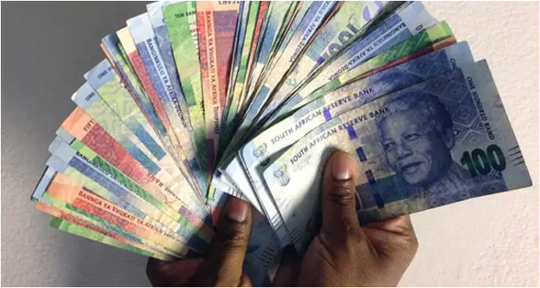
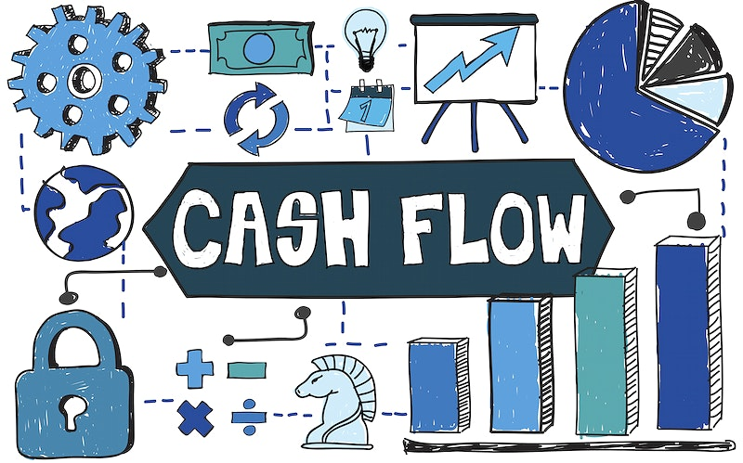
THE FINANCIAL BUSINESS MODEL What should it tell you?
Sales & Profit Forecast for next 12 months
Gross Margin for Pricing Average (as per Policy)
Direct Profit per Product per Market Segment or by Client
Fixed Indirect Cost Overheads
Overheads Breakeven
Variable Indirect Cost Overheads
Contribution to Profit / Net Margin (as per Policy)
Cash Flow Inputs and Outputs + Monthly balance
Investment Input and Output Cash Flow
Repayment Obligations Cash Flow
Brought to you by
In Partnership with

Slide 5
BUSINESS PURPOSE
Sustainability
& Profit
To Create & Distribute Wealth
WHY?
HOW?
SALES
COST of SALES
GROSS PROFIT
EXPENSES
OPERATING PROFIT
TAX
NET PROFIT
DIVIDENDS
RETAINED PROFIT
MONEY THAT STAYS IN THE BUSINESS
MONEY THAT LEAVES THE BUSINESS
INVEST
TRADE
RETURN ON INVESTMENT
Brought to you by
In Partnership with

Slide 6
RETURN ON INVESTMENT FINANCIAL PRODUCTIVITY
MAXIMISE
SALES-COSTS
PRODUCTIVITY = OUTPUT / INPUT
ROI = PROFIT / INVESTMENT (ASSETS)
OUTPUT
PROFIT
TRADING STATEMENT OR PROFIT & LOSS ACCOUNT
INVESTMENT
BALANCE SHEET
INPUT
ASSETS
MINIMISE
Brought to you by
In Partnership with

Slide 7
BALANCE SHEET THE MONEY THAT’S INVESTED INSIDE THE BUSINESS
OWE
OWN
FROM
TO
SHAREHOLDER CAPITAL
RESERVES / RETAINED PROFIT
LONG TERM LOANS
FIXED ASSETS
INVESTMENTS
SHORT TERM LOANS
CREDITORS
TAX & OTHER S-TLIABILITIES
STOCK
DEBTORS
CASH
TRADING PROFIT
OWNERS EQUITY + LIABILITIES = TOTAL ASSETS or INVESTMENTS
Brought to you by
In Partnership with

Slide 8
The PROFIT & LOSS Statement also known as: INCOME STATEMENT
GROSS MARGIN
Gross Profit/Sales x 100%
Direct Costs
Indirect Costs
Direct + Indirect Costs =
Operating Costs
MARKUP
Gross Profit/Cost of Sales x100%
DISCOUNT
Sales less % discount =
Gross Profit less actual discount
i.e. 10% discount yields > reduction in GP
SALES
Cost of Sales
GROSS PROFIT
Overhead Expenses
OPERATING PROFIT
Interest
PROFIT BEFORE TAX
Tax
PROFIT AFTER TAX
Dividends
RETAINED PROFIT
Variable Costs
Fixed Costs
Breakeven
Gross Profit = Overheads
Contribution
Product or Service GP as % of total GP
Brought to you by
In Partnership with

Slide 9
BUSINESS TYPES & AVERAGE MARGINS
BUSINESS GROSS MARGIN MARK-UP NET MARGIN
Manufacturing 40%+ 66% 10%+
Reselling 25-40%+ 33-66% 10%+
Retail Goods 50-80%+ 100-400% 10%+
Retail Foods 30%+ 43% 5%+
Wholesale FMCG 8-20%+ 9-25% <5%
Prof Services 40-90%+ 66-900% 20%+
Building 20-30% 25-40% 5-10%
Transport 30%+ 43% 10%+
Brought to you by
In Partnership with

Slide 10
PRICING for PROFIT
What is the effect of a 15% discount?
 | Month
REVENUE | 200 | Direct Costs Marked Up by 100%
DIRECT COSTS | 100 | Direct Variable Costs of Products/Services
GROSS PROFIT | 100 | Gross Margin 50%
INDIRECT COSTS | 80 | Fixed Expenses Overheads
PBT | 20 | Operating Profit
170
Answer
200 – 15% = 30
GP 100 – 30 = 70
GP has decreased by 30/100 = 30%
Result is an Operating
LOSS (10)
70
(10)
Always be prepared to walk away from a demand for discount
When they request a discount - move immediately to sell your value
Brought to you by
In Partnership with

Slide 11
BUDGETING - YOUR FINANCIAL MODEL
 | JAN | FEB | MAR | APR | MAY | JUN | JUL | AUG | SEP | OCT | NOV | DEC | TOT
REVENUE
DIRECT COSTS
GROSS PROFIT
INDIRECT COSTS
PBT
TAX
PAT
DISTRIB PROFIT
Start with Fixed Costs overheads which are required in running the business and that do NOT vary with Sales. These expenses must be recoverable through Gross Profit and Sales
Estimate the Average Cost of Sales that is represented by the Variable costs of product/service you are selling. These are only incurred when a sale occurs and relate directly to sales
Work out the Breakeven Revenue where Gross Margin =Overheads. The GP% is the GP/Salesx100%
Add the Profit you require for financing growth and recalculate the required Revenue & Gross Profit working from bottom to top line
Begin with overheads then calculate the sales required at the margin of selling that will yield a profit
Brought to you by
In Partnership with

Slide 12
BALANCE SHEET REVISITED
OWE
OWN
FROM
TO
WORKING CAPITAL
Current Assets – Current Liabilities
SHAREHOLDER CAPITAL
RESERVES / RETAINED PROFIT
LONG TERM LOANS
FIXED ASSETS
INVESTMENTS
SHORT TERM LOANS
CREDITORS
TAX & OTHER S-TLIABILITIES
STOCK
DEBTORS
CASH
TRADING PROFIT
COSTS
QUESTION
CAN A BUSINESS SURVIVE WITH NEGATIVE WORKING CAPITAL?
Brought to you by
In Partnership with

Slide 13
PROFIT versus CASH FLOW
CASE STUDY
If I buy R10000 of Butter and I mark it up 100% then achieve sales of R10000 and I pay myself a salary of R2000 and buy a computer for R2000, what is my PROFIT and how much CASH do I have remaining?
PROFIT
SALES 10000
Cost of Sales 5000
Gross Profit 5000
Salary 2000
PROFIT 3000
CASH
Sales 10000
Costs 7000
Computer Investment 2000
CASH BALANCE 1000
YOU ALSO HAVE R5000 INVESTMENT IN STOCK REMAINING
Brought to you by
In Partnership with

Slide 14
CASH FLOW – The Financial Model’s Success Key
EXAMPLE | JAN | FEB | MAR | APR | MAY | JUN | JUL | AUG | SEP | OCT | NOV | DEC
OPENING (a) | 100 | 120 | 150 | 90 | (20) | (20) | (60) | (40) | (20) | (10) | 20 | 20
CASH IN
Sales | 100 | 100 | 150 | 150 | 200 | 200 | 220 | 250 | 250 | 280 | 280 | 150
Debtors | 0 | 200 | 250 | 200 | 200 | 150 | 200 | 210 | 220 | 250 | 220 | 220
Loans | 200 | 0 | 0 | 0 | 0 | 0 | 0 | 0 | 0 | 0 | 0 | 0
TOTAL CASH INFLOW (b) | 300 | 300 | 400 | 350 | 400 | 350 | 420 | 460 | 470 | 530 | 500 | 350
CASH OUT
Expenses | 150 | 150 | 200 | 200 | 200 | 200 | 200 | 220 | 220 | 250 | 250 | 300
Creditors | 80 | 100 | 200 | 200 | 180 | 150 | 180 | 200 | 200 | 200 | 220 | 150
Loans repaid | 0 | 20 | 20 | 20 | 20 | 20 | 20 | 20 | 20 | 20 | 20 | 0
Other / TAX | 50 | 0 | 40 | 40 | 0 | 20 | 0 | 0 | 20 | 30 | 10 | 0
TOTAL CASH OUTFLOW (c) | 280 | 270 | 460 | 460 | 400 | 390 | 400 | 440 | 460 | 500 | 500 | 450
CASH FLOW (d) = (b+c) | 20 | 30 | (60) | (110) | 0 | (40) | 20 | 20 | 10 | 30 | 0 | (100)
CASH BALANCE (e) = (a+d) | 120 | 150 | 90 | (20) | (20) | (60) | (40) | (20) | (10) | 20 | 20 | (80)
Brought to you by
In Partnership with

Slide 15
BUSINESS FINANCIAL MODEL
WHY YOU NEED ONE
RISK: Enables Financial risk reduction through a good planning discipline
VISION: Estimating your Sales & Profit & Cash Flow for 12 months tells your story
GP%: Reveals a stable Pricing Policy for competitive survival & growth
CONTRIBUTION: Allows viability checks per Product / Segment / Customer
BREAKEVEN: Tells you where the cliff edge may threaten you!
VARIABLE COSTS: Shows you the easiest ways to cut costs when you need to
INVESTMENTS: Shows the Cash Flow risks against profitability predictions
CASH FLOW: The most important dimension for survival requires a constant care
LOANS: Easier to get a loan & control repayments with a Cash Flow forecast
CASH: Enables a minimum liquidity target x3mths overheads (SAVINGS!!)
INDISPUTABLE FACT
MOST BUSINESS THAT FAIL (80%+) DO SO SHOWING A PROFIT.
THEY GO BANKCRUPT BECAUSE THEY RUN OUT OF CASH!!
THE REASON FOR THIS IS BECAUSE THEY FAIL TO USE & MANAGE WITH A BUSINESS FINANCIAL MODEL!!!
Brought to you by
In Partnership with

Slide 16
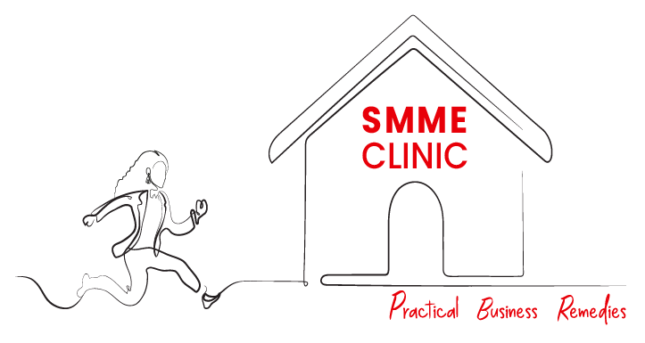

Thank You
Brought to you by
In Partnership with

