Slide 1








EDP / SDP
How to get buy-in from Stakeholders
Brought to you by

Slide 2

CONTENT
THE CHALLENGE
FEAR
TRUST
MOTIVATION
OBJECTIONS
COMMITMENT
Brought to you by

Slide 3
EDP / SDP
Enterprise development / supplier development programmes
According to the B-BBEE Commission, the purpose of the Enterprise and Supplier Development (ESD) is:-
“to promote a conducive environment for creation of sustainable partnerships between Corporate South Africa and black entrepreneurs to enable access and transformation of the value chains.”
THE CHALLENGE
HOW CAN WE MAKE THIS A ‘HAPPY’ EXPERIENCE
&
TURN A ‘NEED’ INTO A ‘WANT’
Brought to you by

Slide 4
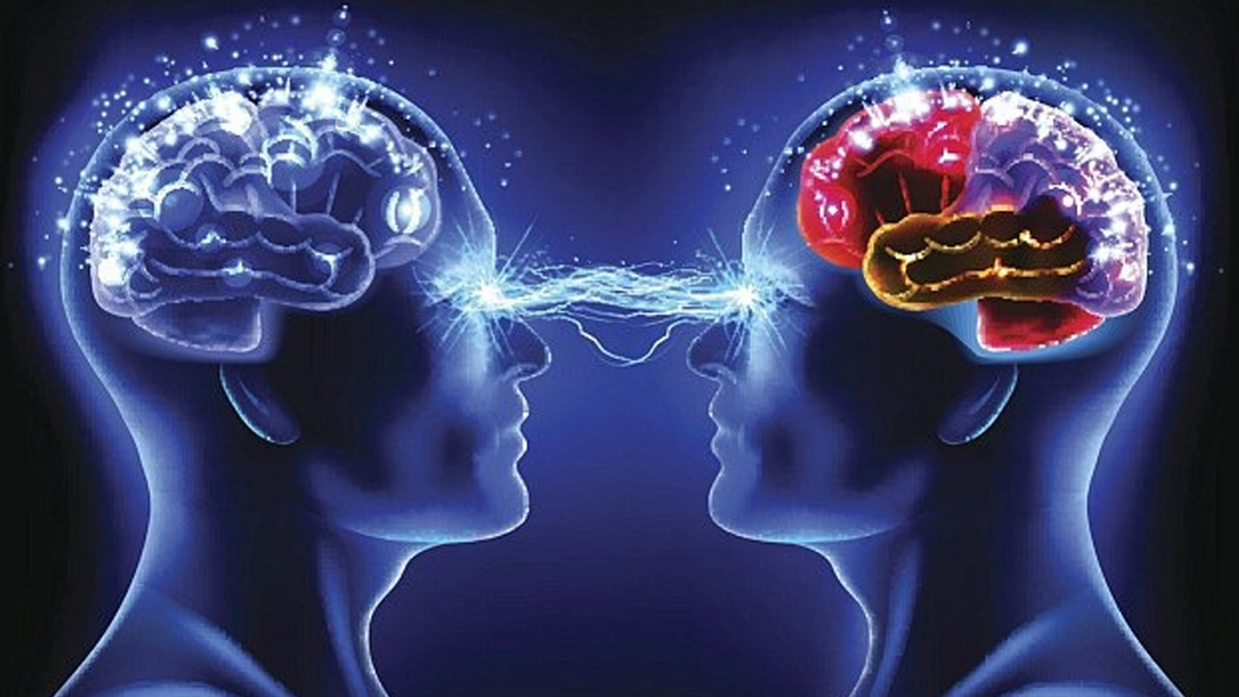
HAPPINESS CHEMISTRY
Stimulating +ve Neuro Transmitters
The MOOD Stabiliser
SERATONIN
Mindfulness
Sun
Nature
Meditation
The REWARD Chemical
DOPAMINE
Eating
Self-care
Goal achievement
Task completion
The LOVE Hormone
OXYTOCIN
Socialising
Helping Others
Touch
Petting Animals
The PAINKILLER
ENDORPHIN
Laughter
Exercise
Music
Movies
Brought to you by

Slide 5
EDP / SDP : STAKEHOLDER PRO’s & CON’s
STAKEHOLDER | MAIN PREJUDICES PAIN POINTS | IMPACT WANTS MOOD STABILISERS | REQUIREMENTS REWARDS
EDP SPONSOR | No Choice Unproductive Expensive | ROI Results Brand exposure | Achieve standards Feedback on results Marketing platforms
EDP MANAGERS | Indirect benefits Proving value Effort | ROI Results Reports | Value measurement Facilitation support Personal recognition
BENEFICIARY OWNERS | Time required Leadership facilitation Limited value | Measurable improvement Application support Specific referencing | Value targeting Extended support Bespoke application
BENEFICIARY EMPLOYEES | Forced participation Effort Limited value | Minimal effort AHA learning Career support | Simplicity & ease Workbooks & exercises Certification
SUPPLIERS | Poor commitment Constant Rescheduling Tick box attitudes | Application effort Value acknowledgement Recall opportunities | Project Income Outcomes achieved Repeat work
DESIGN CRITERIA
Goals / Support / Business Specific (Mindfulness) / Measurement / Fun / Feedback / Recognition
Brought to you by

Slide 6


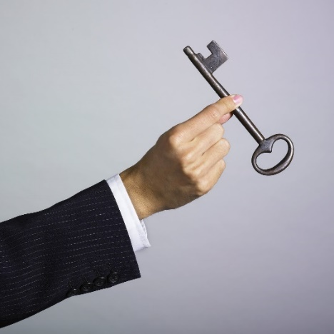




WANT versus NEED
WHAT MAKES PEOPLE want to invest?
Desirable human traits = fitness indicators
symbolism v materialism
the signals people send each other
EDP / SDP
WHAT ARE FITNESS INDICATORS?
WHAT IS YOUR SYMBOLIC MESSAGING SIGNAL?
OXYTOCIN
Helping Others
Brought to you by

Slide 7
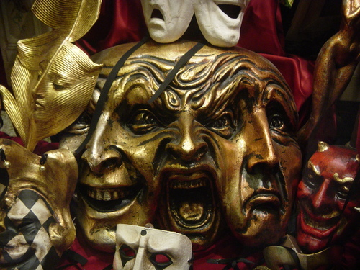
FEELINGS – Their Limbic Response
UNDERSTAND THEIR PRIMAL FEELINGS
* The desire that leads to an intention (predation, pursuit or ownership) cannot be measured logically
Don’t feed them Logic!!
* ‘Spin a web’ of sensual subtlety to engage feelings
Feed them Stories!!
EMOTIONS are more persuasive than FACTS
And VISION is more influential than MISSION
YOU CANNOT BORE SOMEONE INTO SAYING “YES”
EVERYTHING YOU DO IS A MATTER OF PRESENTATION AND PERSUASION!!
At APPLE COMPUTERS product development must engage the senses before it can gratify the intellect
Brought to you by

Slide 8

A PROCESS for PERSUASION
DISSOLVE THEIR PRIMARY FEAR
DEVELOP TRUST
PROVIDE MOTIVATION
HANDLE THEIR OBJECTIONS
GET THEIR COMMITMENT
Brought to you by

Slide 9

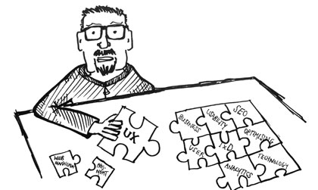


DISSOLVE their PRIMARY FEAR
“ I’M NOT TRYING TO SELL YOU ANYTHING”
Let’s Solve together
OXYTOCIN
RELIEF SERATONIN
Mindfulness
EXPECTATION DOPAMINE
Feel Good
Brought to you by

Slide 10
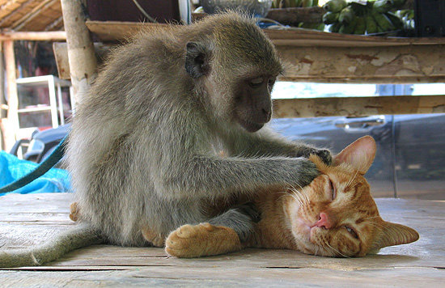
TRUST
THEIR EMOTIONAL NEEDS
CERTAINTY – Your Belief
SIGNIFICANCE – Their Power
RAPPORT – The Relationship
It’s about THEIR AGENDA – not YOURS!
Brought to you by

Slide 11

DEVELOPING TRUST
#1: LIFE AREAS
FINANCE – SCORECARD BENEFITS
SOCIAL - CONNECTIONS
SPIRITUAL - MORALITY
CAREER – NETWORKS
LEARNING – KNOWLEDGE
VITALITY – HEALTH
TEAM – SUPPORT
#2: OTHER FEARS
AUTHORITY – SHARED DECISIONS
VANITY – THEIR SIGNIFICANCE
EFFORT – SUPPORT ONLY
ASK
LEADING QUESTIONS
Brought to you by

Slide 12

MOTIVATION – Their Will & Determination
WIIFM The 3 Levels | MOTIVATION I WANT TO
PERSONAL | SPONSORS: Recognition / Achievement etc BENEFICIARIES: Knowledge / Skills / Advancement etc SUPPLIERS: Income / Reputation / Image etc
BUSINESS | SPONSORS: Brand support / Scorecard Points etc BENEFICIARIES: Productivity / Innovation / Progress etc SUPPLIERS: Growth / Influence / Marketing etc
SOCIETY | SPONSORS: Patriotism / Humanitarian support etc BENEFICIARIES: Contribution / Employment creation etc SUPPLIERS: SME business support / Skills development etc
Brought to you by

Slide 13

OBJECTIONS
VALIDATING VALUE
A 3 STEP PROCESS
1. CLARIFY WHY?
2. AGREE their THINKING
3. OUTWEIGH with BENEFITS
Brought to you by

Slide 14


GETTING COMMITMENT
IS ANYTHING STANDING IN YOUR WAY?
IF YES – HANDLE OBJECTION
IF NO – MAY WE PROCEED WITH YOUR SUPPORT?
“You can get anything you want in life if you just help enough other people get what they want”
Zig Zigglar
Brought to you by

Slide 15


Thank You & GOOD LUCK
Brought to you by

