Slide 1







SMME Clinic Community Building
Jodene Shaer – Self-Awareness Coach
Focus Beyond the Fear:
Why Your Best Efforts to be Mindful and Calm During Times of Uncertainty
Brought to you by
In Partnership with

Slide 2

Meet Your Mind!
Protector
Defender
Warrior
Brought to you by
In Partnership with

Slide 3

You know Focus is important, but why is it so challenging?
Busy and Racing Mind
Restlessness and Impatience
Discomfort with Stillness
Can’t Let Go of Control
External Distractions
Negative Self-Talk
Brought to you by
In Partnership with

Slide 4

Complex Nature of the Mind and its Tactics to Resist Focus
Repetitive thought patterns
Default Mode
Fixation
Procrastination
Focus on the Unknown
Brought to you by
In Partnership with

Slide 5

The Ego's Resistance to Surrendering Control
What is the Ego mind?
The ego’s need for Self-Preservation
Fear of Vulnerability
Attachment to the Past
Obsession with the Future
Brought to you by
In Partnership with

Slide 6
Facing the Resistance Head On
Observing your Mind for Self-Awareness
Tailoring your Mindfulness
Letting Go of Expectations
Working with Wilfulness to Reclaim your Power
Brought to you by
In Partnership with

Slide 7

Steps to Keep the Mind Out of Fear: F.A.I.T.H
Focus
Acceptance
Intention
Trust
Happiness
Brought to you by
In Partnership with

Slide 8

Cultivating a Supportive Environment for a Calm Mind
Environment
Time and Routine
Social Support
Digital Detox
Mindful Relationships
Self-Care Practices
Brought to you by
In Partnership with

Slide 9
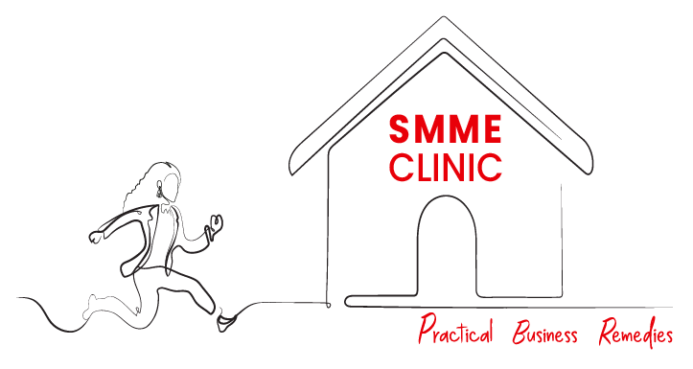
Thank You
Brought to you by
In Partnership with

