Slide 1






SMME Clinic Community Building
Anton Ressel
Beating Impostor Syndrome – Finding your Unique Value
Brought to you by
In Partnership with

Slide 2
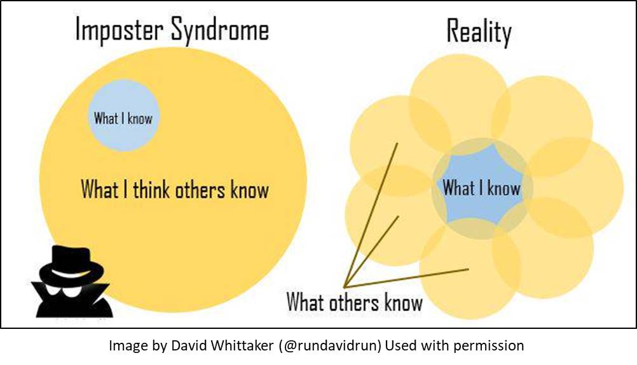

Slide 3


IMPOSTOR SYNDROME – AM I WORTHY?
Two main symptoms:
Constantly questioning if you are worthy of:
  Your success
  Your opportunities
  Your seat at the table
  Consistent fear of being exposed as a fraud
          Will I be asked something I cannot answer?
          Will I make a fool of myself?
          Will my house of cards come crashing down?
Brought to you by
In Partnership with

Slide 4
THE REAL TRUTH – EVERYONE HAS BLIND SPOTS
The Five Types of Impostor Syndrome:
The Perfectionist – sets impossibly high goals and feels like a failure if 99% are reached
The Natural Genius – coasted at school and tertiary education, but encounters more challenges as their career progresses
The Rugged Individualist – struggles to ask for help, fearing that this is a sign of weakness
The Expert – Perfect can be the enemy of good – always needs to be 100% sure and prepared before speaking up or presenting a piece of work
The Superhero – works harder than everyone to try and prove their worth
Thanks to Dr Valerie Young, co-founder The Impostor Institute
Brought to you by
In Partnership with
YOUR LOGO HERE

Slide 5
FIND YOUR UNIQUE VALUE - & CLAIM YOUR SPACE!
The Perfectionist – accept your mistakes and know that they are an inevitable part of growth & progression, & celebrate your successes
The Natural Genius – we are all ‘a work in progress’, from famous musicians to elite athletes. Practice the skills you don’t master easily or immediately
The Rugged Individualist –speak to successful people and ask them specifically who contributed to their success – someone always did!
The Expert – challenge yourself to ‘learn on the go’ and avoid hoarding knowledge. Recognize your ability to improvise when needed
The Superhero – define your success in ways beyond work, move away from external validation of your worth and set healthy boundaries!
Thanks to Dr Valerie Young, co-founder The Impostor Institute
Brought to you by
In Partnership with

Slide 6
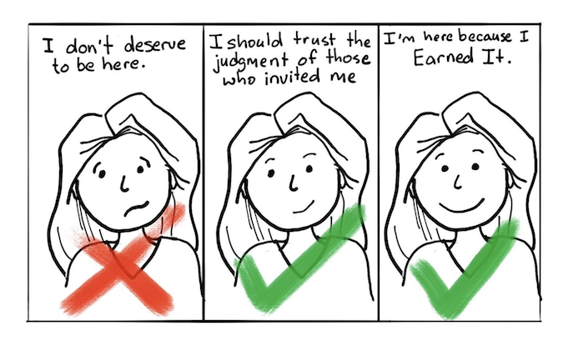

Slide 7

Tips for Entrepreneurs
Claim your Space
Be comfortable with what you know, and what you do not know
Don’t be afraid to ask – for help, for clarity, for time
Build on your successes
Remember, sales is a mutual exchange of value!

Slide 8

Thank You
Brought to you by
In Partnership with

