Slide 1
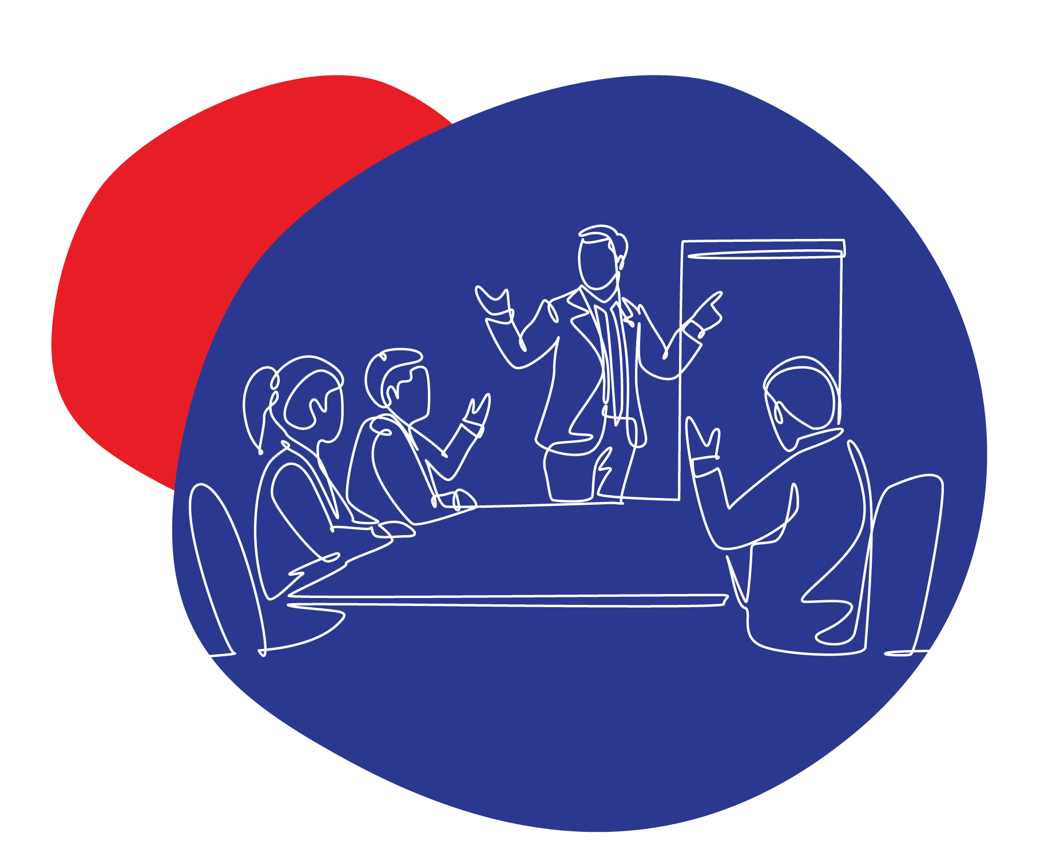





SMME Clinic Community Building
Este Pretorius
www.boostsales.live
Brought to you by
In Partnership with

Slide 2

Notes:
Who feels a little like my furry friend?
A little bit like you’ve now caught the tire, but you’re not sure what to do with it?
# 1 complaint I get from sales folk is they are spending too much time on LinkedIn and not getting results.
So there’s good news and bad news:

Slide 3
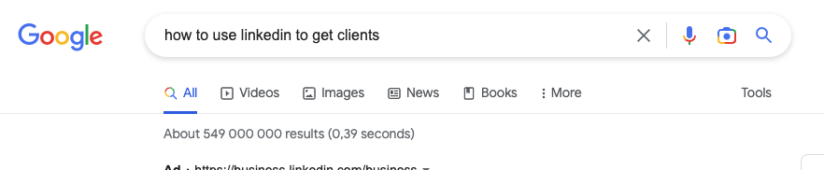
There are a little under 3.5 billion search results to the query “How To Use LinkedIn to get clients”
No wonder people are not getting results.
Notes:
Well not so much
There are 3.5 billion search results
seriously as a business owner do you really have the time to to scroll through 3.5 billion search results – just let that sink in for a bit. 3.5 billion!
And even worse, how much of those results are actually tried and tested as opposed to be just theory – so it’s no wonder that the majority of business owners and marketers are saying they don’t get results on LinkedIN

Slide 4
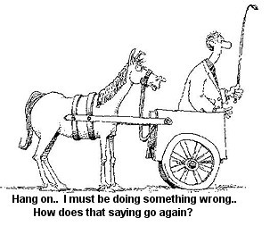

Slide 5
What problem do I solve and for who
(not what do I sell…)

Slide 6
I help (who do you help) (what do you help them with, in what time frame, achieve what results) without (what will they not have to do to achieve the results)
1
2
3

Slide 7
I help business consultants (who) increase their sales to 50k per month in 90 days (achieve what) without tech overwhelm or spending a tonne of cash (without)
I help ready to scale, B2B entrepreneurs (who) use science-backed methodologies to attract and convert qualified business leads for sustainable, ethical business growth using LinkedIn (achieve what), without spending a cent on advertising (without)
Helping high performance executives (who), achieve and maintain a healthy lifestyle within 90 days (achieve what), without going on a restrictive diet (without)

Slide 8
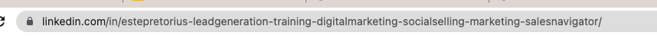
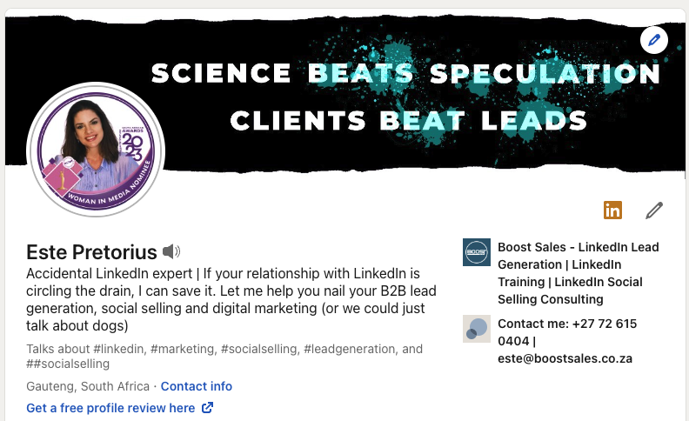
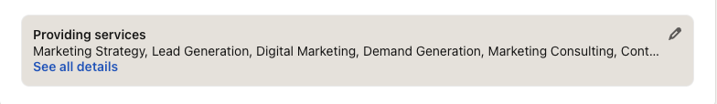
1
2
3
4
6
5
7
Notes:
So before you start connecting you need to ensure your profile is 100% optimised – there are 23 pieces of real estate that you can use – and I call them real estate because that’s exactly what they are.
We don’t have time to go through the whole profile today but I will have a surprise for you at the end of the session

Slide 9
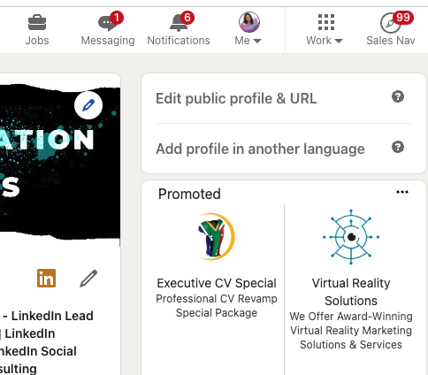
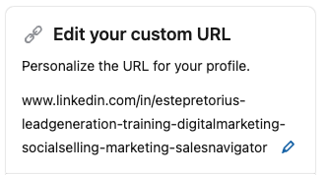
BOOST BITE: Use words that you know people are searching for when they look for your services (keywords)
1
You can use a combination of your name, title and keywords that people would search for
3-100 letters or numbers
Do not use spaces, symbols, or special characters
Notes:
So before you start connecting you need to ensure your profile is 100% optimised – there are 23 pieces of real estate that you can use – and I call them real estate because that’s exactly what they are.
We don’t have time to go through the whole profile today but I will have a surprise for you at the end of the session

Slide 10
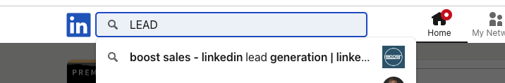
BOOST BITE: Keywords are KEY WORDS!!!! You want to be found!
1
Notes:
So before you start connecting you need to ensure your profile is 100% optimised – there are 23 pieces of real estate that you can use – and I call them real estate because that’s exactly what they are.
We don’t have time to go through the whole profile today but I will have a surprise for you at the end of the session

Slide 11
CUSTOMISE YOUR BANNER: Don’t sell – trigger, be scarce with corporate logos, and look at it as a conversation starter
2
TO EDIT
Use canva.com or graphic designer (google for inspiration)
Save your banner using your keywords
Ensure the image/creative you use is high res and not pixelated
Don't have any creative to the left of your banner as your face will cover it
Do the "close eye - open eye" test
Refer back to your BRAND STATEMENT!
Notes:
So before you start connecting you need to ensure your profile is 100% optimised – there are 23 pieces of real estate that you can use – and I call them real estate because that’s exactly what they are.
We don’t have time to go through the whole profile today but I will have a surprise for you at the end of the session

Slide 12


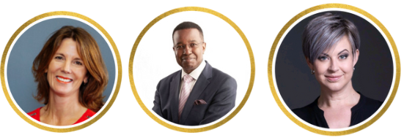

PROFILE IMAGE : Test how your photo will be perceived at https://www.photofeeler.com/
3
Busy
Unprofessional
Difficult to see
Clean
Professional
Inviting
Notes:
So before you start connecting you need to ensure your profile is 100% optimised – there are 23 pieces of real estate that you can use – and I call them real estate because that’s exactly what they are.
We don’t have time to go through the whole profile today but I will have a surprise for you at the end of the session

Slide 13
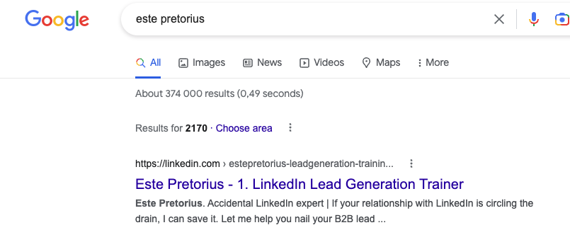
YOUR HEADLINE: Test your headline at https://headlines.sharethrough.com/
4
You want someone to click on your profile - and your profile image and profile headline follow you everywhere!
220 characters - add your most important keywords in the first 60 - 80
Incorporate some symbols to break up text
Consider adding adjectives, phrases, a goal, personal mantra together with your keywords to make it interesting
Notes:
So before you start connecting you need to ensure your profile is 100% optimised – there are 23 pieces of real estate that you can use – and I call them real estate because that’s exactly what they are.
We don’t have time to go through the whole profile today but I will have a surprise for you at the end of the session

Slide 14
SOME TEMPLATES : Test your headline at https://headlines.sharethrough.com/
4
[Unique attribute] | [Audience-oriented description of what you do] | [Personality-driven statement] | Accidental LinkedIn expert | If your relationship with LinkedIn is circling the drain, I can save it | Let me help you nail your B2B lead generation, social selling and digital marketing (or we could just talk about dogs)
I help you get [Benefit] through [Mechanism] | [Credibility] | [Topic 1] → [Topic 2] → [Topic 3] | I help you close high-ticket deals through SPIN selling | Over $15M in sales generated for clients | Sales → Psychology → Networking
My [Digital asset] will help you get [Benefit] | [Social proof] | [Title] | My marketing newsletter will make you smarter | Over 15,000 subscribers agree | CMO at Nike
[Unique attribute] + [Credibility] | I teach [Audience] to get [Desired benefit]. [CTA] | Ex-Googler with 10 years in the software industry | I teach young developers how to use LinkedIn to get better jobs. Follow me for free tips and content
I help [Audience with X characteristics] achieve [Y goal]. [Relevant question]. [CTA]. | I help men over 40 recover their energy. Fitness coach. Want to feel stronger, younger, and unstoppable? Shoot me a DM.
[Doing X] for [Audience 1] and [Audience 2] | [Title] | Writing email copy for solopreneurs and C-level execs | Founder @ Faraday Agency
Notes:
So before you start connecting you need to ensure your profile is 100% optimised – there are 23 pieces of real estate that you can use – and I call them real estate because that’s exactly what they are.
We don’t have time to go through the whole profile today but I will have a surprise for you at the end of the session

Slide 15
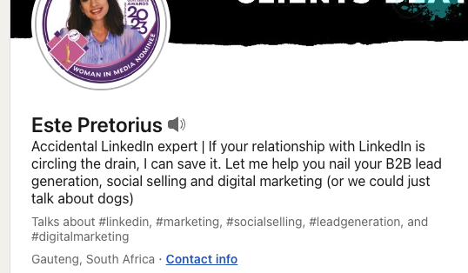
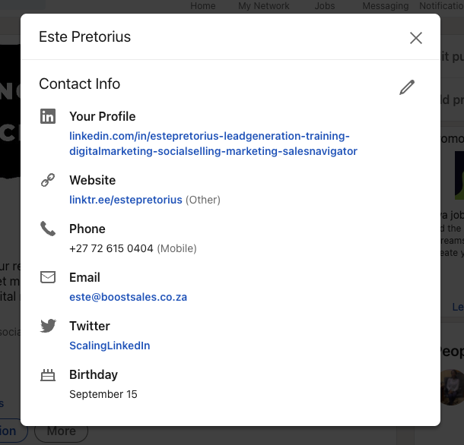

BOOST BITE: https://linktr.ee/ creates one link for all your social media profiles
5
TO EDIT
Notes:
So before you start connecting you need to ensure your profile is 100% optimised – there are 23 pieces of real estate that you can use – and I call them real estate because that’s exactly what they are.
We don’t have time to go through the whole profile today but I will have a surprise for you at the end of the session

Slide 16
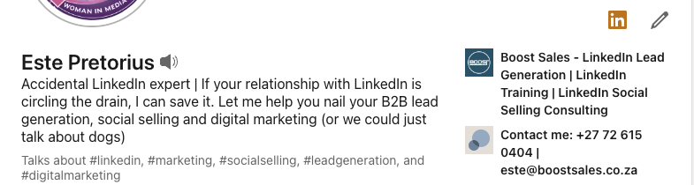
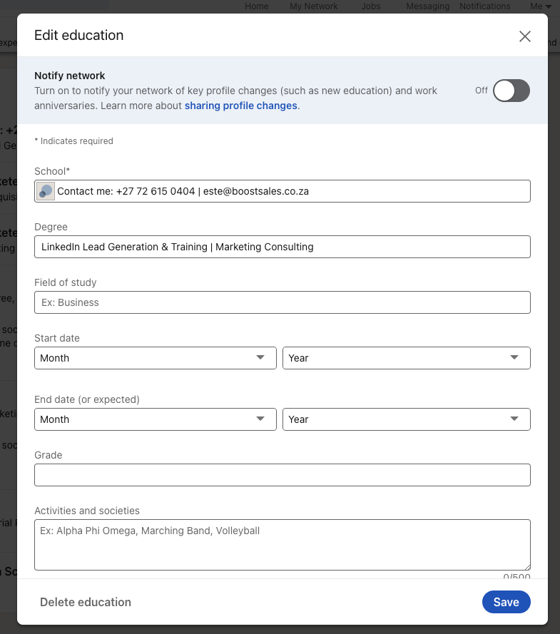
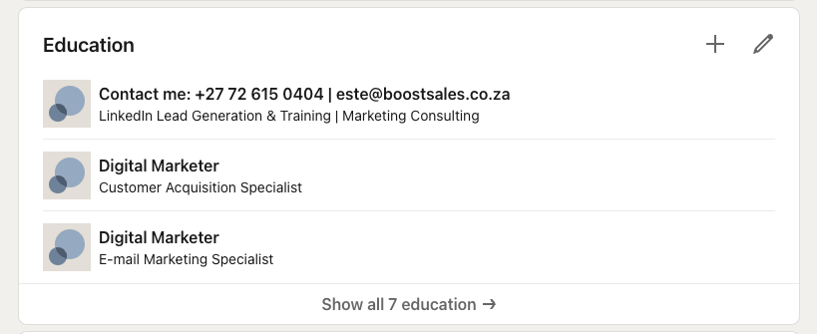
EDUCATION HACK: Make sure the “Contact Me” education is the first one on the list
6
TO ADD
Notes:
So before you start connecting you need to ensure your profile is 100% optimised – there are 23 pieces of real estate that you can use – and I call them real estate because that’s exactly what they are.
We don’t have time to go through the whole profile today but I will have a surprise for you at the end of the session

Slide 17
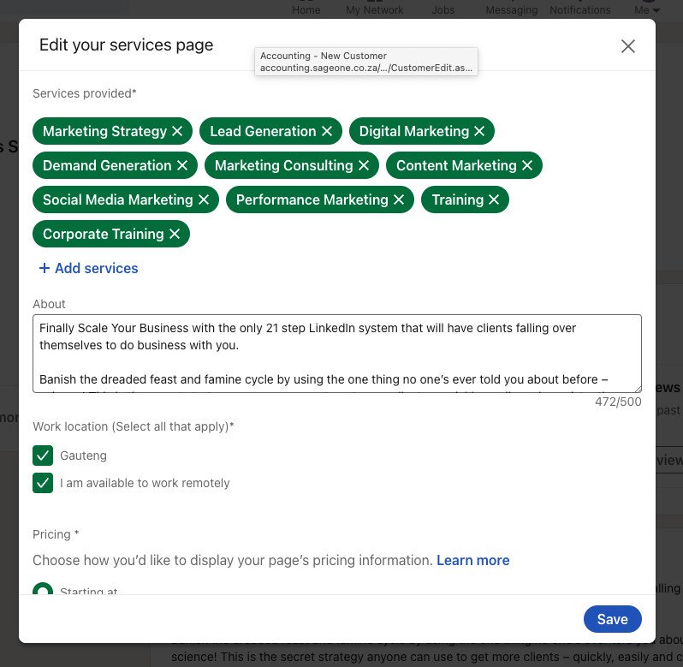
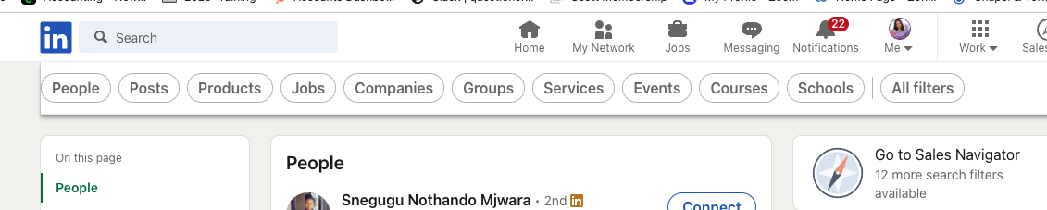
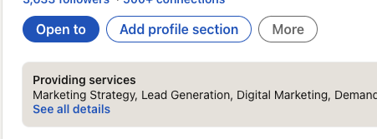
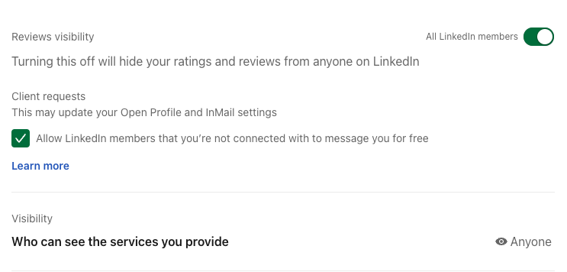
BOOST BITE: Prospects can now search for you via the services you offer
7
ADD ABOUT COPY
You can add up to 10 services from a predefined LinkedIn list
If you do not have "providing services" join the SMP group - https://www.linkedin.com/groups/8871270/ and it will be activated on your profile
Notes:
So before you start connecting you need to ensure your profile is 100% optimised – there are 23 pieces of real estate that you can use – and I call them real estate because that’s exactly what they are.
We don’t have time to go through the whole profile today but I will have a surprise for you at the end of the session

Slide 18

Notes:
I cannot stress this enough - The worst thing you can do after connecting is going in for the hard sell. Like my friends over at Gong say, this is not a baseball game, so stop pitching!

Slide 19

I’m here to help…get your newly edited profile reviewed by me for free
(only 5 spots available)
https://boostsales.live/ppp

Slide 20
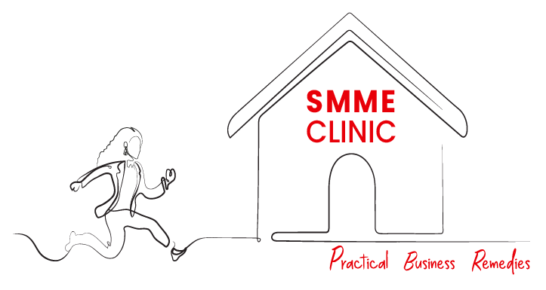
Thank You
Brought to you by
In Partnership with

