Slide 1
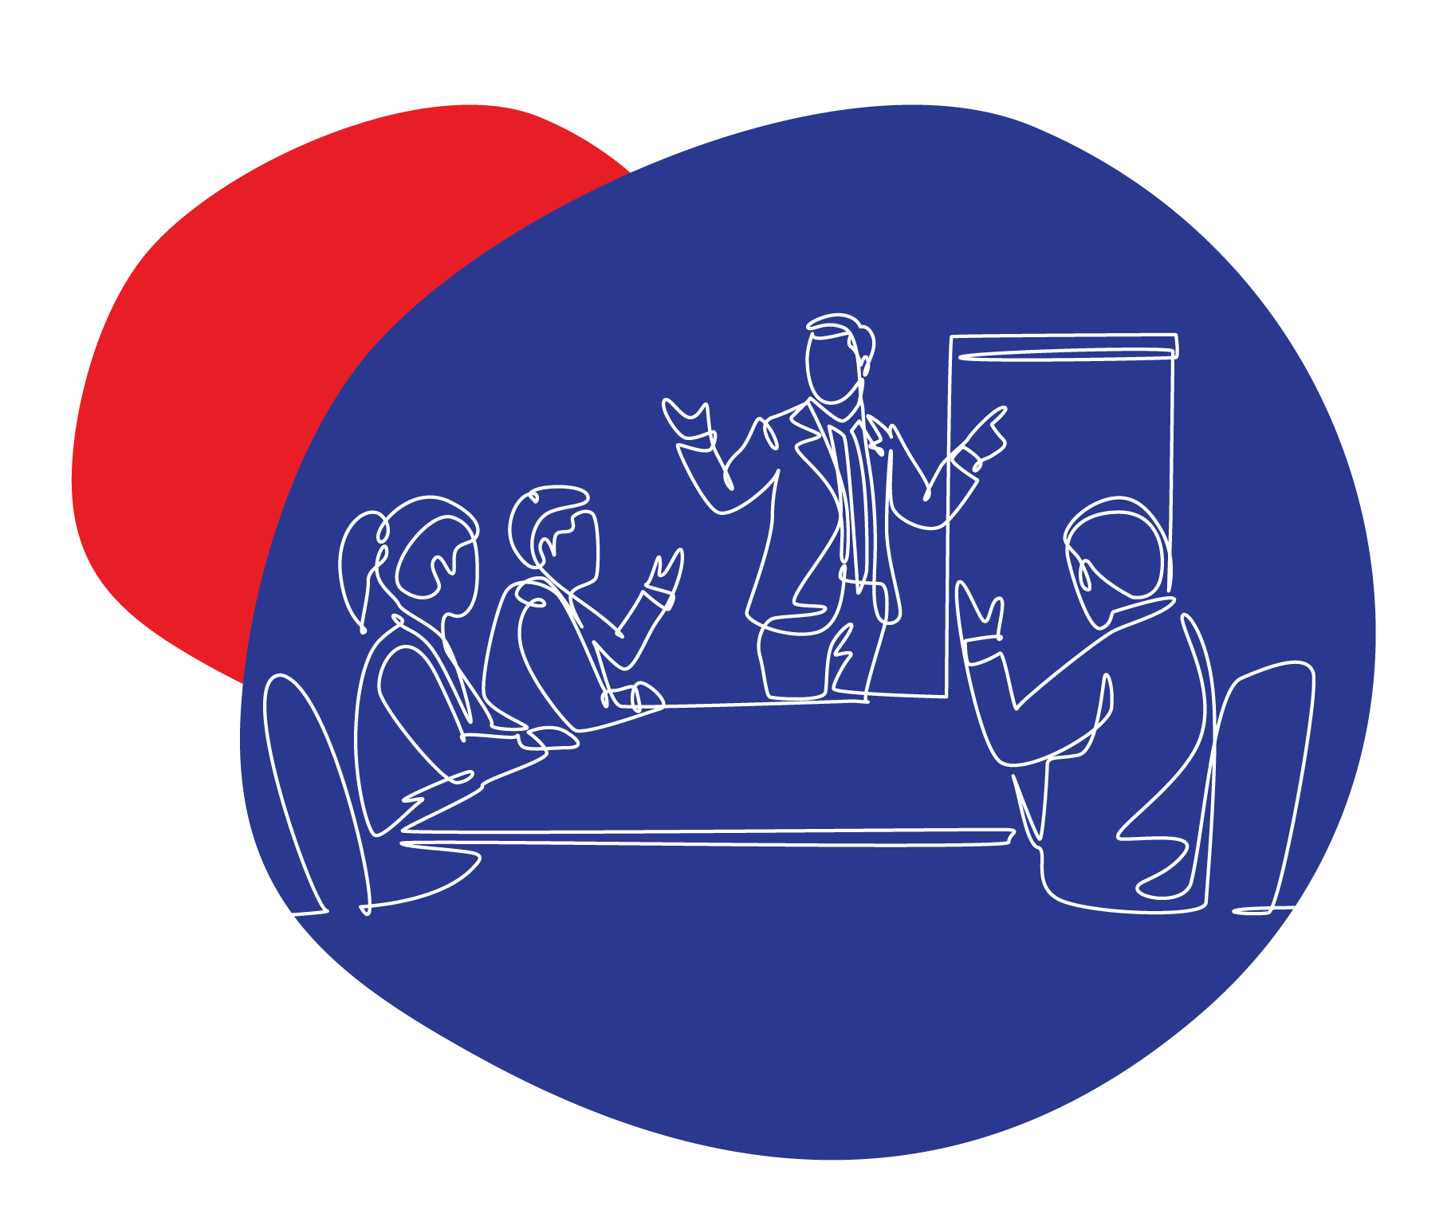





Mental Health @Work
Kulani Shiluvane
Founder and Chief Solutionist at Shiluvah
Brought to you by
In Partnership with

Slide 2

Disclaimer
The information provided by Shiluvah (Pty) Ltd and its employees’ associates etc is not designed as a treatment for individuals experiencing a mental health condition.
Nothing in this masterclass should be viewed as a substitute for professional advice (including, without limitation, medical advice).
Brought to you by
In Partnership with

Slide 3
Agenda:
Top causes of people developing mental illness @work
Common signs and symptoms
How to create a work environment that is conducive to mental wellbeing
Brought to you by
In Partnership with

Slide 4
What is Mental Health
Mental health is a state of well-being in which an individual realizes their own abilities, can cope with the normal stresses of life, can work productively and can contribute to their community.
Mental health includes our emotional, psychological, social and financial well-being.
Mental health is fundamental to our collective and individual ability as humans to think, emote, interact with each other, earn a living and enjoy life.
It is important to note that a person can experience poor mental health and not be diagnosed with a mental illness.
Likewise, people diagnosed with mental illness can experience a period of physical mental and social well-being.
Brought to you by
In Partnership with

Slide 5

Top causes of people developing Mental Illness @Work
Inadequate health & safety policies
Poor management and communication practices
Limited/low levels of control over one’s area of work
Unclear tasks and/or objectives
Low levels of support
Inflexibility in the workplace
Brought to you by
In Partnership with

Slide 6
Common Signs & Symptoms of Mental Illness
Signs and symptoms of mental illness can vary, depending on the disorder, circumstances and other factors. Mental illness symptoms can affect emotions, thoughts and behaviours.
Feeling sad or down
Confused thinking or reduced ability to concentrate
Excessive fears or worries, or extreme feelings of guilt
Extreme mood changes of highs and lows
Withdrawal from friends and activities
Significant tiredness, low energy or problems sleeping
Inability to cope with daily problems or stress
Trouble understanding and relating to situations and people
Problems with alcohol or drug use
Major changes in eating habits
Sex drive changes
Excessive anger, hostility or violence
Suicidal thinking
Brought to you by
In Partnership with

Slide 7
How to create a work environment that is conducive to mental wellbeing
Creating safe spaces for people to be open about mental health issues
Invest in proactive mental health wellness programmes
Train and develop managers on mental health issues
Understand that employees are people
Strive for a work-life balance
Brought to you by
In Partnership with

Slide 8
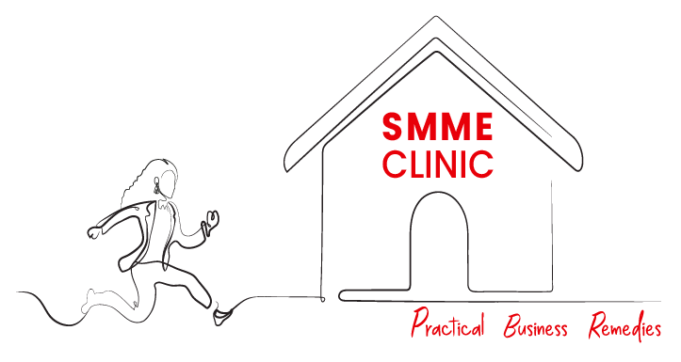
Thank You
Brought to you by
In Partnership with

