Slide 1








How to get them to buy regardless of price
Paul Hartnady
profitlab@iafrica.com
Brought to you by
In Partnership with

Slide 2
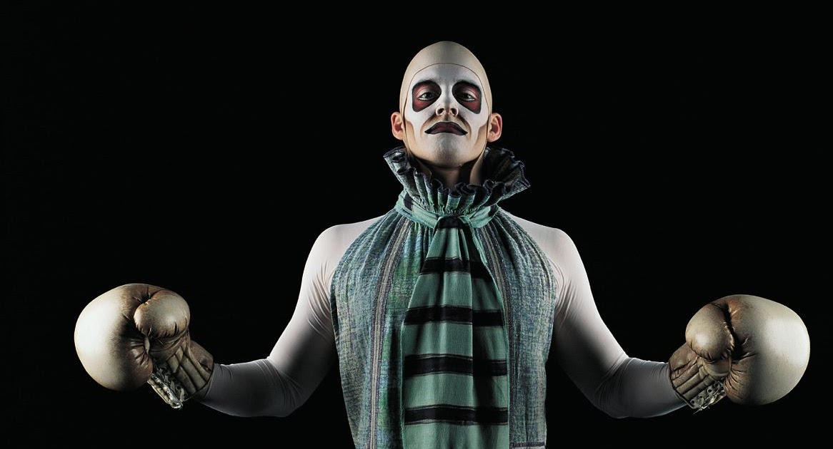
HOW to get them to BUY regardless of PRICE
INNOVATION
FEELINGS
VALUE
Brought to you by
In Partnership with

Slide 3
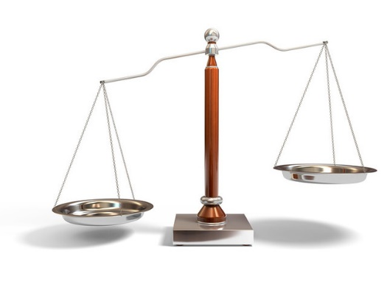
PRICE
PRICE
VALUE
WHEN IS PRICE A DOMINANT ISSUE ?
THE OFFER TRANSACTION | PRICE DEPENDENT | STRATEGY GET TO A NEGOTIATION ASAP
TENDER | YES | Lowest Price
QUOTE | YES | Variable Price dependent on add-ons
PROPOSAL | SOMETIMES | Differentiation Value and Choices
1-2-1 SELLING | NEVER | Handle Price Objections
1-2-many PRESENTATION | NEVER | Buyer Influences & Value propositions
NEGOTIATION | NEVER | Negotiate Price with Terms & Conditions
NO SELLING INVOLVED
{
{
SELLING ONLY
Brought to you by
In Partnership with

Slide 4

HOW TO GET THEM TO BUY REGARDLESS OF PRICE
CONTENT
WHAT UNLOCKS THEIR motivation TO BUY? (I want TO)
THE vital INGREDIENT
Blue ocean strategy
L-e-a-p
WIIFM
YOUR last(ing) impression
WHAT UNLOCKS THEIR COMMITMENT TO BUY? ( I can & WILL)
Professionalism
VALUE INNOVATION
Influencing THE Influencers
GOOD MANNERS
“”You can get anything you want in life, as long as you help enough other people to get what they want”
ZIG ZIGLAR
FEELINGS – VALUE – INNOVATION
Brought to you by
In Partnership with
FEELINGS – VALUE – INNOVATION

Slide 5






WHAT UNLOCKS THEIR MOTIVATION TO BUY? The VITAL INGREDIENT
ATTITUDE
- The unshakeable conviction that you will succeed
- Having a truly positive belief & expectation that you will win
- ALWAYS looking on the bright side for a positive result
It’s desire (not ability) that determines success
Other ATTRIBUTES of
Good Attitude
CARE
HUMILITY
CURIOSITY
ENTHUSIASM
ACCOUNTABILITY
Brought to you by
In Partnership with

Slide 6

WHAT UNLOCKS THEIR MOTIVATION TO BUY?
BLUE OCEAN STRATEGY:Change the Competitive Boundaries
Head-to-Head Competition | BOUNDARIES | BLUE OCEAN FOCUS
Substitutes | INDUSTRY | Alternatives
Competitive Positioning | MARKETS | Strategic Groups
Better Service | BUYERS | User Group Focus
Maximises Value | SCOPE | Offers Complementary Services
Improves Price Performance | FUNCTION | Rethinks Functionality
Adapts to External Trends | TIME | Shapes Trends
EXAMPLES
Remote Control v Phone App
Virgin Active v Curves
Small Desktop Copiers
Water filtering off taps
Swatch (Budget fashion)
iTunes
Don’t get eaten in the RED ocean of bloody competition!!
Make competitors irrelevant
Brought to you by
In Partnership with

Slide 7
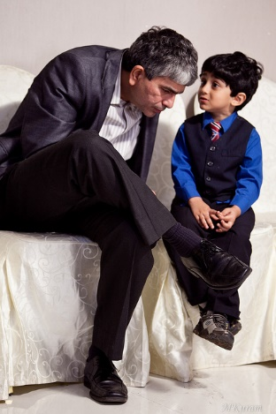


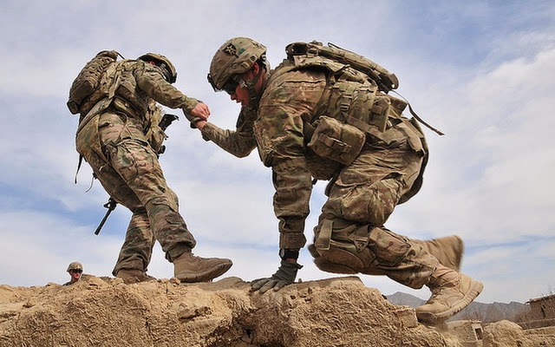
WHAT UNLOCKS THEIR MOTIVATION TO BUY? L – E – A - P
CHARISMA
The Magical Art of Personal Magnetism
LISTENING
Presence
POWER
Authority
ENERGY
Warmth
ALIGNMENT
with their Interests
Connection
Brought to you by
In Partnership with

Slide 8





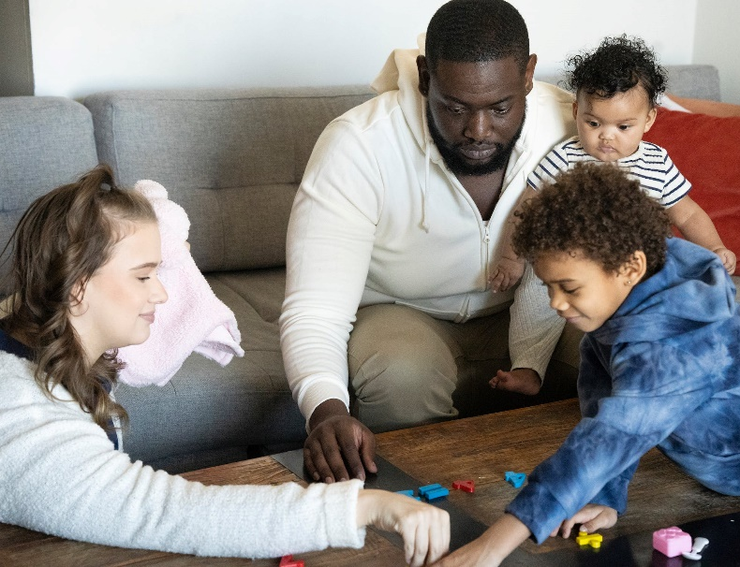


ALIGNMENT – with their HIGHEST INTERESTS
THE 7 LIFE AREAS
FINANCE
SPIRITUAL
FAMILY
CAREER
CULTURE
HEALTH
LEARNING
Brought to you by
In Partnership with

Slide 9




WHAT UNLOCKS THEIR MOTIVATION TO BUY? DO I WANT TO?
MOTIVES
PERSONAL – BUSINESS – SOCIAL
VISION
RESULTS
SERVING HUMANITY
BUYING EMOTIONS
HEALTH – SECURITY – PRESTIGE – FEAR of LOSS – PRIDE – EGO – AMBITION – STATUS – GREED
Brought to you by
In Partnership with

Slide 10
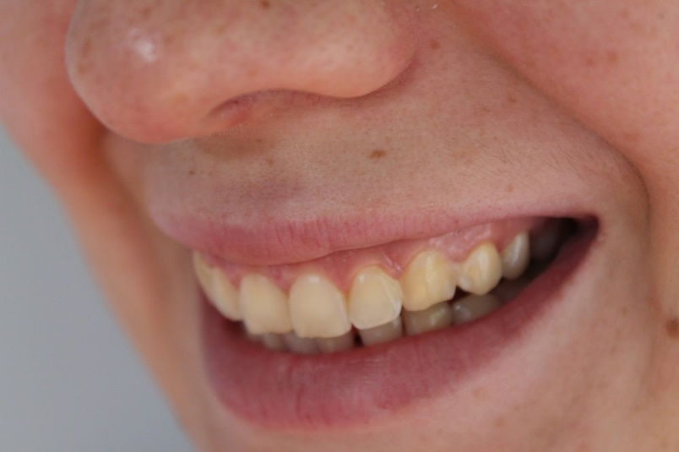



WHAT UNLOCKS THEIR MOTIVATION TO BUY? YOUR LASTING IMPRESSION
FIRST CONTACT CREATES AN IMPACT IMPRESSION
BUT
THE WAY YOU LEAVE THEM CREATES A LASTING IMPRESSION
MOOD MEMORY
THEY ARE MORE LIKELY TO REMEMBER HOW YOU MADE THEM FEEL THAN WHAT YOU SAID
Brought to you by
In Partnership with

Slide 11
WHAT UNLOCKS THEIR MOTIVATION TO BUY? YOUR LASTING IMPRESSION
LIFE GRAVITY
Pain – Work – Uncertainty
LIFE FORCE
Health – Relations – Self
BE AUTHENTIC
Which means:-
Have no fear of being Wrong
(& no guilt when you are wrong)
And make the Connections you want
Brought to you by
In Partnership with

Slide 12

PART 2: COMMITMENT WHAT UNLOCKS THEIR COMMITMENT TO BUY?
AS ATTITUDE IS THE VITAL INGREDIENT IN THEIR MOTIVATION
PROFESSIONALISM
IS THE KEY COMPONENT FOR GETTING THEM TO COMMIT
THE 10 RULES of SALES PROFESSIONALISM
1. VALIDATE THEM WITH GOOD BODY LANGUAGE
2. DISSOLVE THEIR FEARS
3. USE THEIR NAMES
4. TEACH THEM SOMETHING THEY DON’T KNOW
5. GET THEIR PERMISSION BEFORE YOU SELL ANYTHING
6. HANDLE THEIR OBJECTIONS WITH SKILL
7. WATERPROOF THE SALE
8. SAY THANK YOU
9. BE AUTHENTIC
10. KEEP CONTROL OF THE SALES CYCLE
1.
Brought to you by
In Partnership with

Slide 13
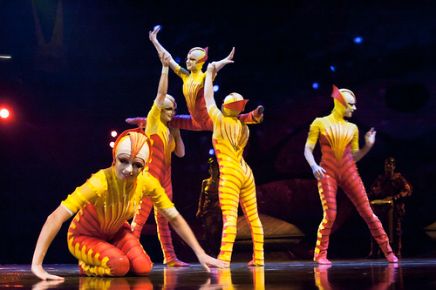

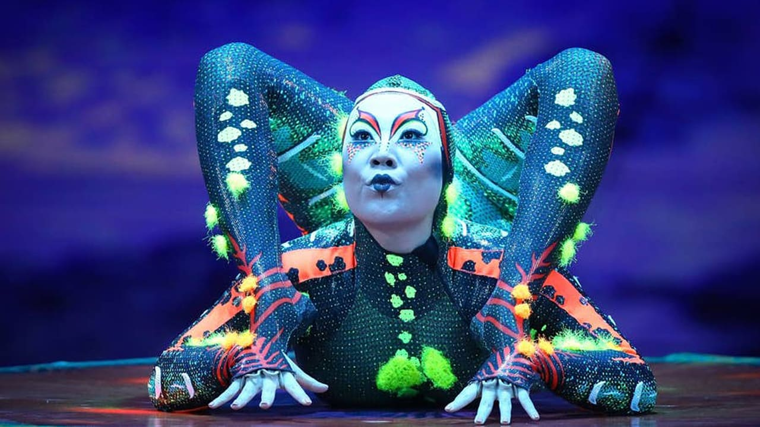
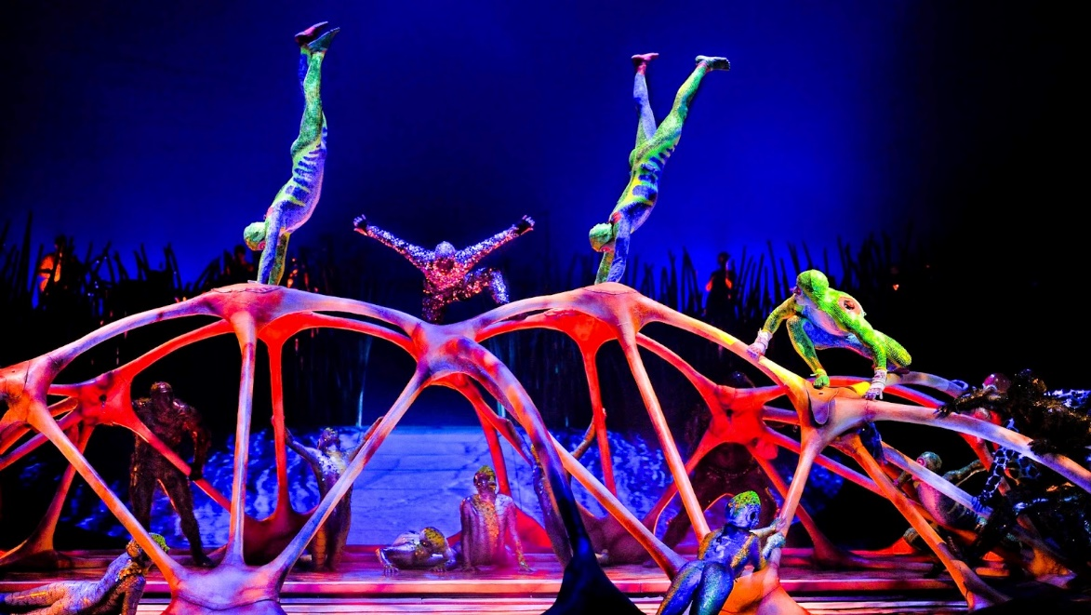
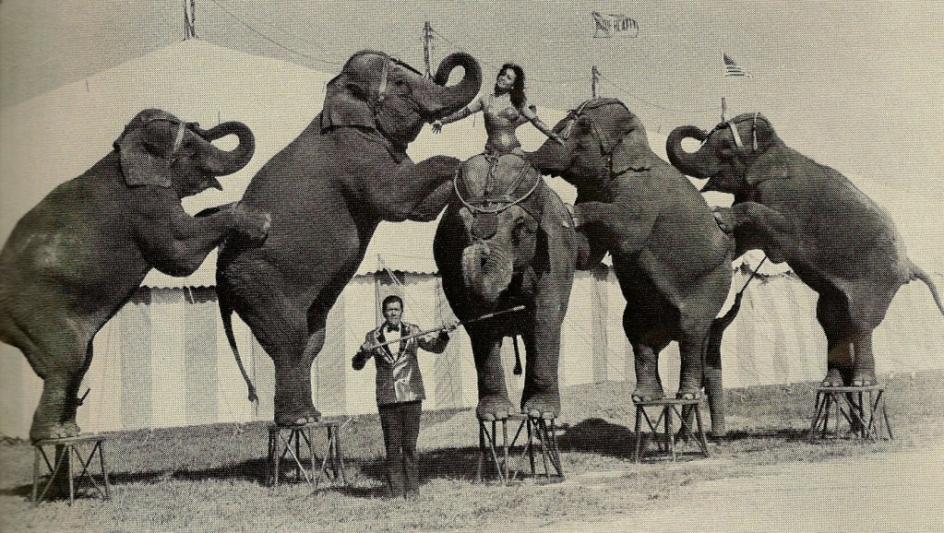
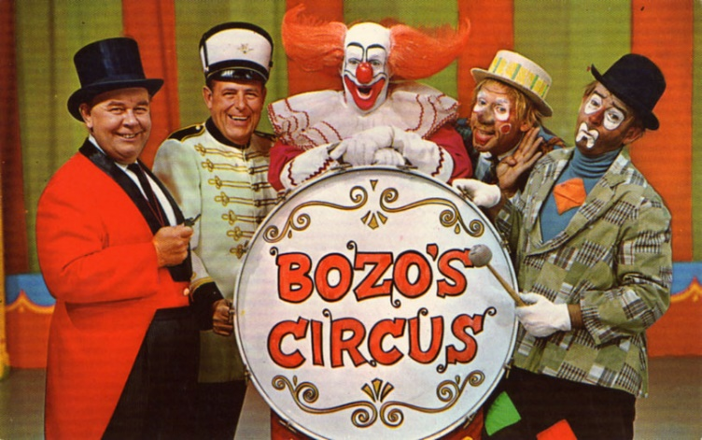
WHAT UNLOCKS THEIR COMMITMENT TO BUY?
VALUE INNOVATION
Brought to you by
In Partnership with

Slide 14

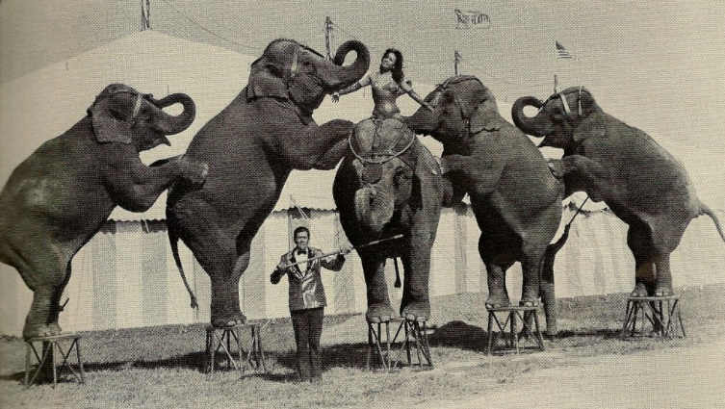


FOUR ACTIONS
OF
VALUE INNOVATION
CIRQUE de SOLEIL
REDUCE
Below Industry STDS
ELIMINATE
Factors the Industry takes for granted
CREATE
STDS never before seened
NEW VALUE
RAISE
Factors well above Industry STDS
PRICE
Brought to you by
In Partnership with

Slide 15
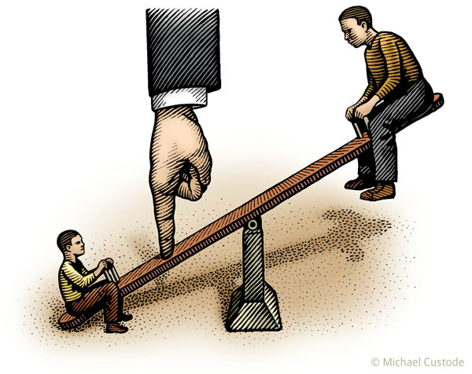
WHAT UNLOCKS THEIR COMMITMENT TO BUY? HANDLING OBJECTIONS SKILLFULLY VALIDATING YOUR VALUE
CLARIFY
AGREE THEIR THINKING
OUTWEIGH
Brought to you by
In Partnership with

Slide 16

WHAT UNLOCKS THEIR COMMITMENT TO BUY?
INFLUENCING their Will & Determination
CONNECTION | BELIEF YES I CAN | MOTIVATION YES I WANT TO
PERSONAL VALUES & PRIORITIES | WIIFM | WIIFM
BUSINESS VISION & GOALS | WIIFM | WIIFM
SOCIETY CAUSES & COLLABORATION | WIIFM | WIIFM
Brought to you by
In Partnership with

Slide 17
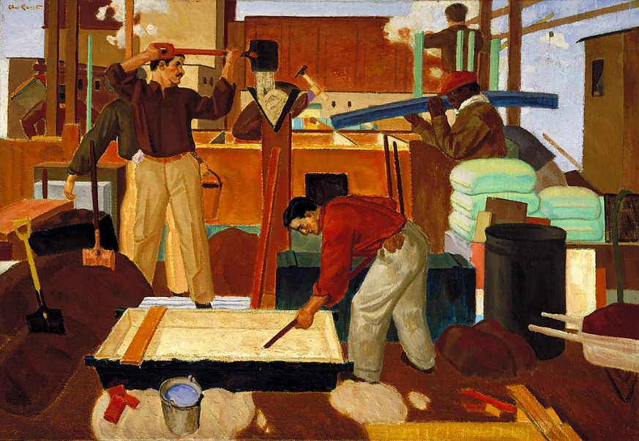

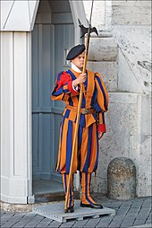
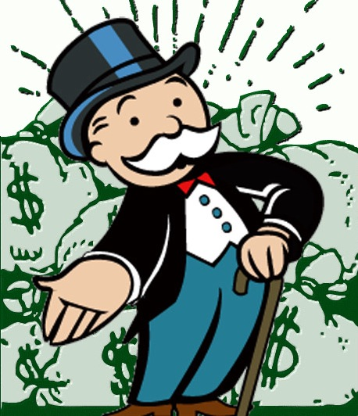

WHAT UNLOCKS THEIR COMMITMENT TO BUY?
KNOW HOW TO RESPOND TO BUYER INFLUENCERS
Introductions
Endorsement power
THE SPONSOR
THE USERS
THE GATEKEEPER
THE FINANCIER
THE SIGN-OFF
Quality & Service
Sabotage power
Performance NOT Price
Veto Power
BLUE OCEAN
FOCUS
Terms & Conditions
Power - Can’t say yes
CAN say NO
Strategic Visionary
Helicopter View
Leader Power
Brought to you by
In Partnership with

Slide 18
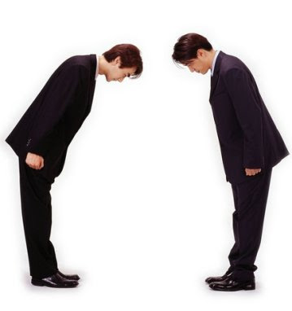



WHAT UNLOCKS THEIR COMMITMENT TO BUY?
Practicing GOOD MANNERS
CULTURAL SOCIAL
UNIVERSAL SOCIAL
Making People around you feel comfortable (unthreatened)
POLITENESS
RESPECT
CARE
CONSIDERATION
LOVE
UNIVERSAL PERSONAL
INDIVIDUAL PERSONAL
Waterproof the Sale
“It is one of the most beautiful compensations of life, that no man can sincerely try to help another without helping himself”
Ralph Waldo Emerson
Brought to you by
In Partnership with

Slide 19
HOW to get them to BUY regardless of PRICE REVIEW
The VITAL Ingredient: Total belief and conviction that you will WIN
Blue Ocean Strategy: Value Innovation that makes competitors irrelevant
L-E-A-P: The 4 elements of Charismatic persuasion
Their Self-interest Hierarchy: The 7 Life Areas for your offer alignment
What’s In It For Me? Personal – Business – Social Motivators
Your Lasting Impression: A ‘Feel-Good’ Authentic Mood Memory of your Life Force
Professionalism: Validation – Fear – Teaching – Permission
Objections: Clarify – Agree their thinking – Outweigh
The Influencers: Sponsor – User – Gate Keeper – Financial – Control
Good Manners: Politeness – Respect – Care – Consideration
Brought to you by
In Partnership with

Slide 20
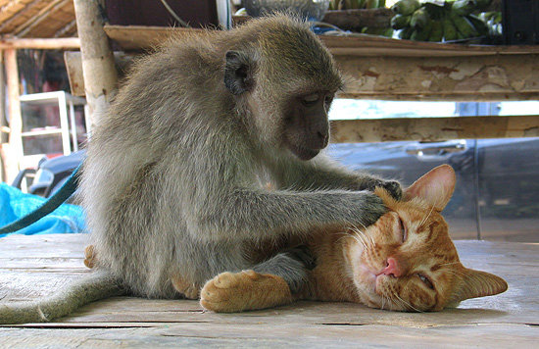
THANK YOU & GOOD LUCK!!
“Much of the benefits in friendship lies in accepting & honouring our differences”
James L Fredericks (Theologian)
“Our energy is proportionate to the resistance it meets”
William Hazlet (17C essayist)
“Polarised tendencies possess within their opposites, positive & productive energy for best achievements”
Kathy Kolbe (Pure Instinct)
Brought to you by
In Partnership with

Slide 21
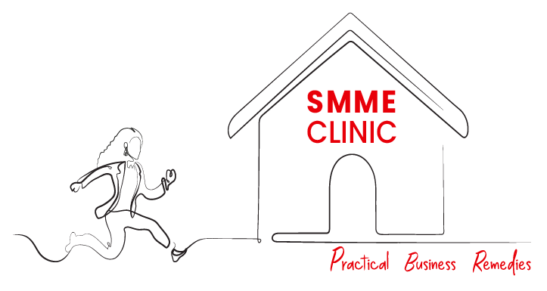
Thank You
Brought to you by
In Partnership with

